Slide 1
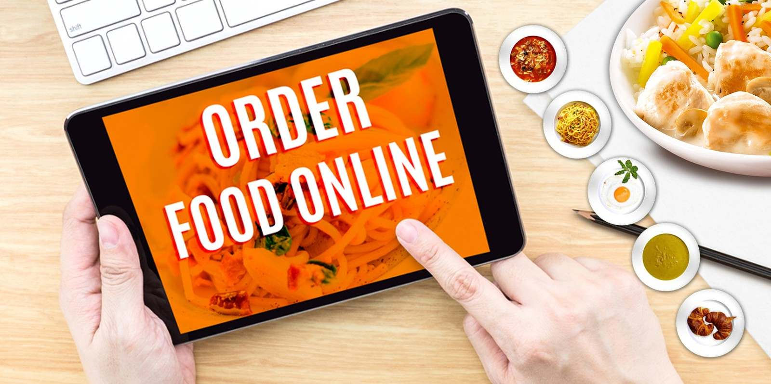
SIZZLY-FOOD ORDER WEBSITE

Slide 2
Do you wish to have a delicious bite of butterscotch cheesecake in the middle of the day at work or a hearty biryani meal for lunch?
Moving out of your house, facing the relentless traffic, unending queues at the restaurants and cafes, waiting for your order, etc., sounding demotivating as always.
Sizzly- a food order website which meets the customer requirements delivering freshly delicious sizzling hot food at their door step.
It can be used by customers seeking various delicious food and order it online which is delivered in shortest possible time while the food is sizzling hot.

Slide 3
The main languages used:
1.HTML
2.CSS
3.JavaScript

Slide 4
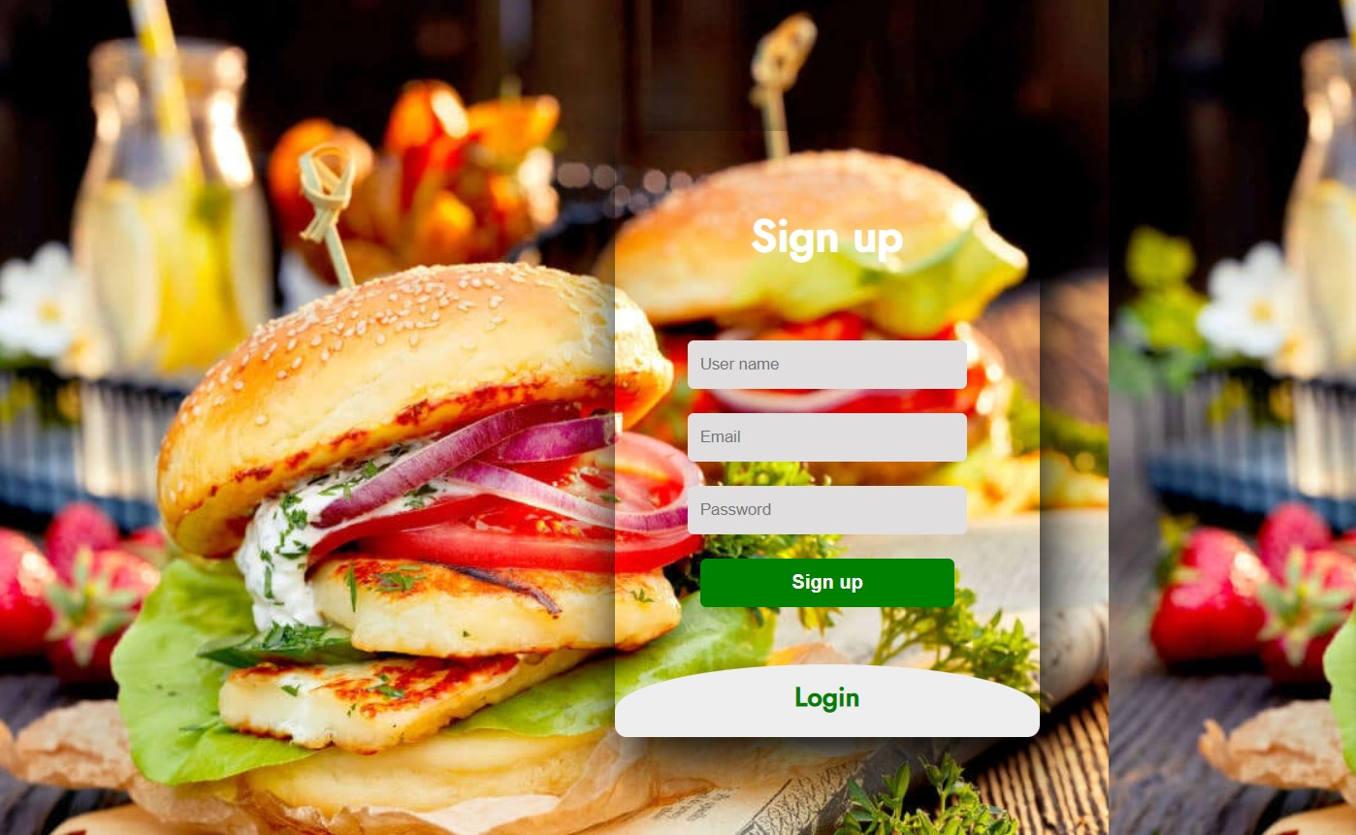

Slide 5
Login and sign up page main elements used:
HTML:
1.form
2.div
3.a (anchor tag)
CSS:
Background image
Transform
box

Slide 6
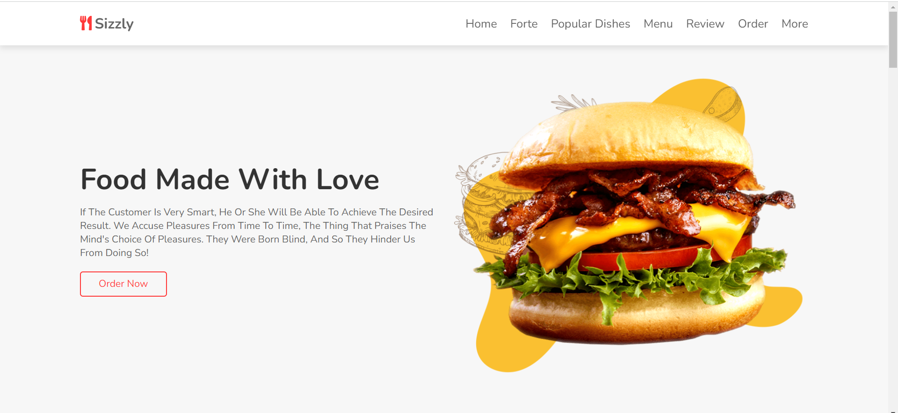

Slide 7
Home page main elements used:
HTML:
Semantic tags- header, footer, section
div, span
img, h3, p, i
Script, link, a
Formatting tags
CSS:
margin, border, padding and formatting styles
animation, transition, hover
display, position, webkit
JavaScript:
querySelector
classList
setInterval

Slide 8
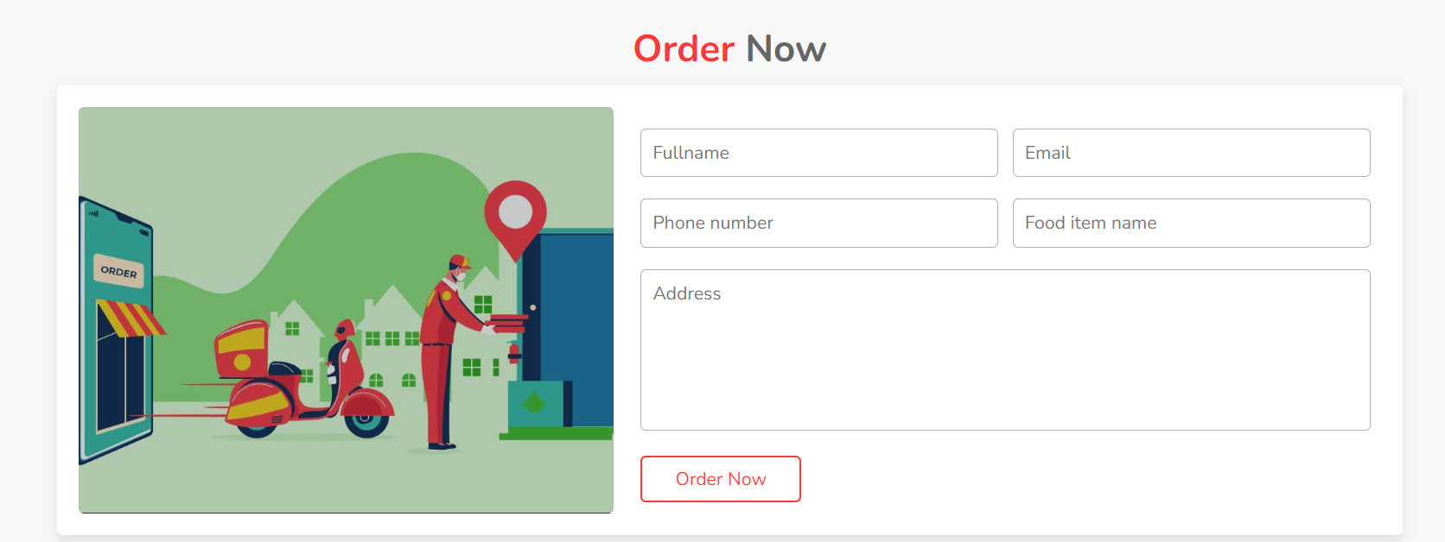

Slide 9
Order now main elements used:
HTML:
1.form elements
2.Img
3. Formatting tags
CSS:
1.padding, margin, border
2.display, flex-wrap

Slide 10
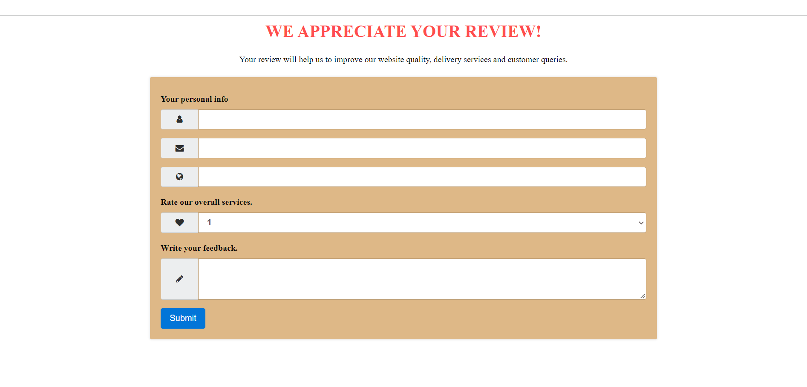

Slide 11
Review page main elements used:
HTML:
1.form elements
2.anchor tag
3. Formatting tags
CSS:
1.padding, margin, border
2. transition, hover
3. background, box-shadow

Slide 12

2111CS020002
2111C0020029
2111CS020057
2111CS020071
2111CS020081

